Slide 1

Understanding Markets with Data Science
(Team 3)
April 20, 2022

Slide 2



Team Members
Saurabh Aggarwal
Siddharth Sen

Slide 3
Agenda
Problem Statement
Motivation
Methodology
Results
Implications
Future Steps
Questions

Slide 4
Problem Statement
Deduplication in Online Discussion Forums

Slide 5
Motivation
# Users (↑)
Discussion Forums are getting more crowded as time passes by
(StackOverflow/ Quora)
New things to query about
Difficult to find what you are looking for among the forest
-------------------------------------------------------------------------------------------------------------------------------------
Deduplication of questions will help consolidate information from all similar threads into one
This will result in the user having to spend less time to find a solution, less storage and computation on the backend.
Enabling fewer questions overall and better answers to all questions.

Slide 6
Methodology
Data:
We used the data from a 2017 Kaggle Competition on Sentence Similarity. The dataset given had ~400k Quora Questions Pairs.
Approach:
Data Cleaning
Stopword Removal
Stemming
Lemmatization
Model Details
Optimizer: Adam (cross-entropy loss)
batch_size: 64
# units in LSTM: 50
# epochs: 10 (Hardware limitations)
learning rate: 0.001
Modeling
Siamese Neural Network
with LSTM
and Manhattan Distance for similarity

Slide 7
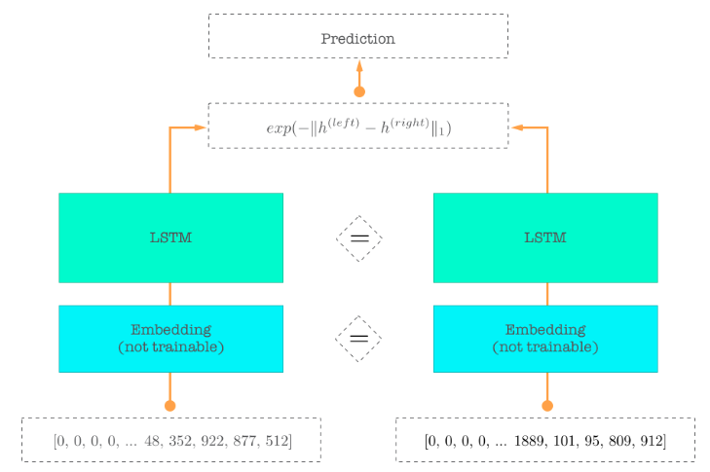
Siamese Networks (Background)

Slide 8
Results
Test Accuracy: 83.48%
Confusion Matrix:
 | Pred 0 | Pred 1
True 0 | 22914 | 2238
True 1 | 4370 | 10478
Precision (TP/(TP+FP)): 0.824
Recall (TP/(TP+FN)): 0.7
8

Slide 9
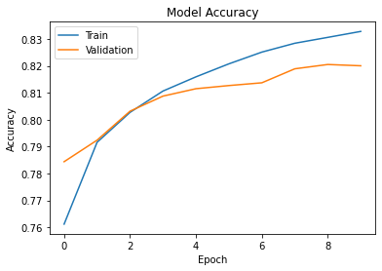
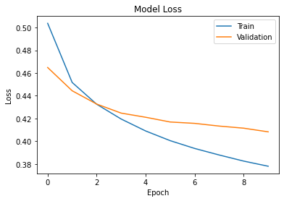
Accuracy/ Loss Plots
9

Slide 10
Implications
From our predictions we can see that, we can reduce the size of our Test set from 80,000 questions to 67,284 if we keep only unique questions.
A ~16% decrease (not considering chaining)
This reduction will aid in speeding up query search, reduce data storage required, and finally, improve user experience.
10

Slide 11
Future Work
Running the model for longer till the loss stabilizes.
Identify chains of similar questions (in addition to just pairs) – by permuting dataset.
Real-Time identification of similar question
(If a user is typing a new question, we can search if any similar question has already been asked (and answered) and refer the user to that post)
11

Slide 12
Thank You
Question & Answer

